Slide 1
2D drawing basics
For CSE 3902

Slide 2
Overview
2D coordinate systems
Raster images
Sprite drawing in XNA

Slide 3
Coordinate system
A coordinate system is a system which uses one or more numbers, or coordinates, to uniquely determine the position of a point
For a 2D coordinate system, we need
Origin
2-Tuple of position relative to the origin

Slide 4
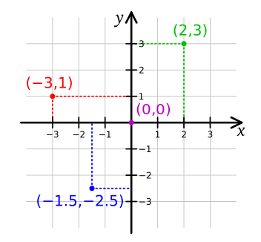
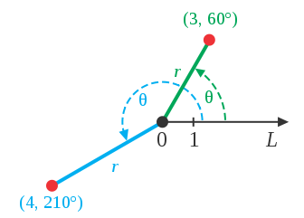
2D coordinate system examples
Cartesian Coordinates
(http://en.wikipedia.org/wiki/File:Cartesian-coordinate-system.svg)
Polar Coordinates
(http://en.wikipedia.org/wiki/File:CircularCoordinates.svg)

Slide 5
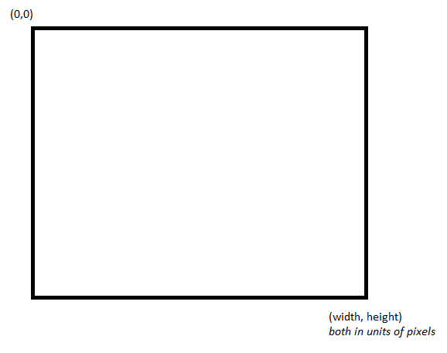
XNA’s coordinate system

Slide 6
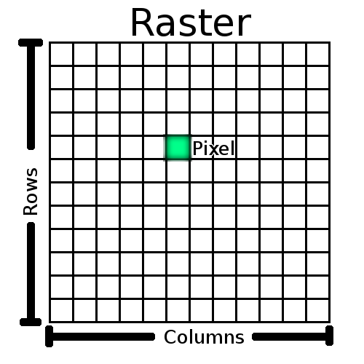
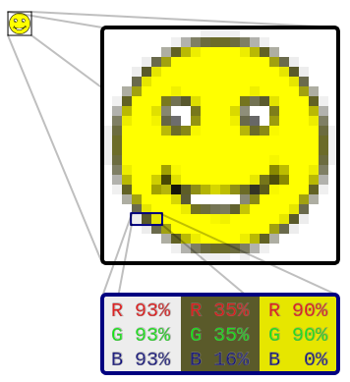
Raster images
http://docs.qgis.org/2.0/en/docs/gentle_gis_introduction/raster_data.html
http://en.wikipedia.org/wiki/File:Rgb-raster-image.svg

Slide 7
Raster image types
PPM
Uncompressed, human readable
GIF
8 bits per pixel per channel (RGB)
JPEG
Lossy data compression
PNG
Lossless data compression
More details on some of these formats (http://paulbourke.net/dataformats/ppm/)

Slide 8
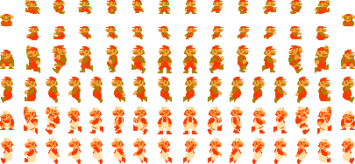
Comparing image types
Image:
Source
http://www.mariouniverse.com/images/sprites/nes/smb/mario.png
PNG ~6.42 kb
GIF ~12.8 kb
JPEG ~55.3 kb
BMP ~223 kb
PPM ~852 kb
----------------------------
Source code for NES SMB ~32 kb
See
http://web.cse.ohio-state.edu/~kirby.249/3902/ImageTypes/
for image files ; no NES ROM for obvious copyright reasons

Slide 9
Sprite drawing in XNA
SpriteBatch object
Begin (call once to start specifying sprites to draw)
Draw (each call specifies another sprite to draw)
End (call once to finish specifying sprites to draw)

Slide 10

SpriteBatch Draw methods
public void Draw (
Texture2D texture,
Rectangle destinationRectangle,
Color color
)
Example Image File / Texture2D
public void Draw (
Texture2D texture,
Rectangle destinationRectangle,
Nullable<Rectangle> sourceRectangle,
Color color
)
Drawing window
XNA rectangle object

Slide 11
More examples
See last tutorial linked in Sprint0 list
http://rbwhitaker.wikidot.com/monogame-texture-atlases-1
See example linked in course calendar
ManualAnimatedSprite.cs

